Slide 1
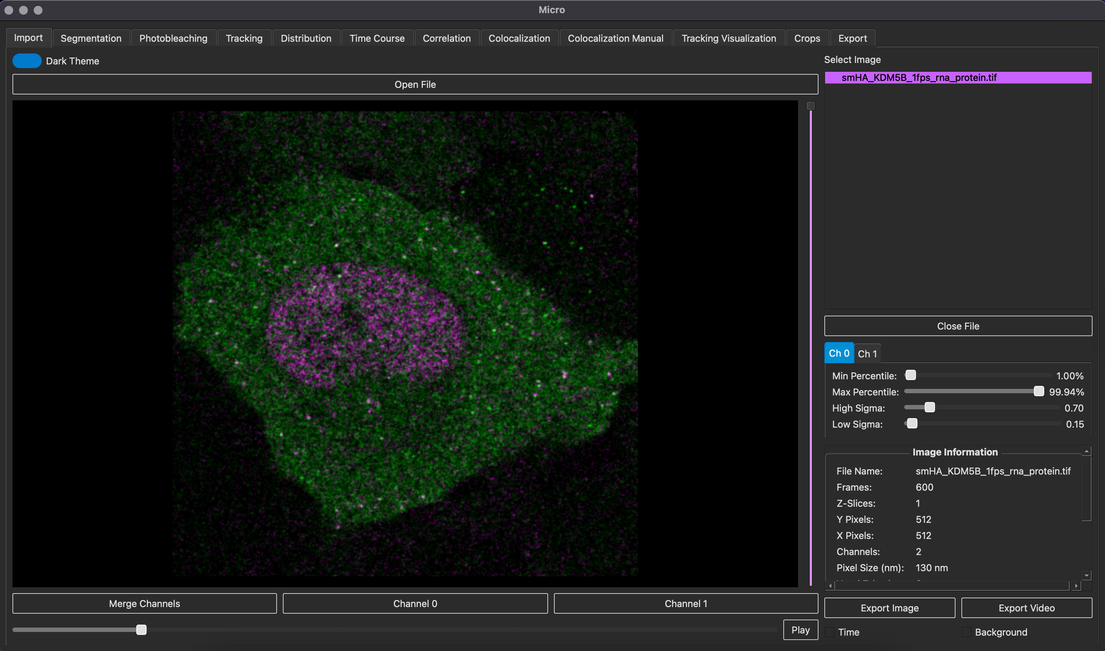
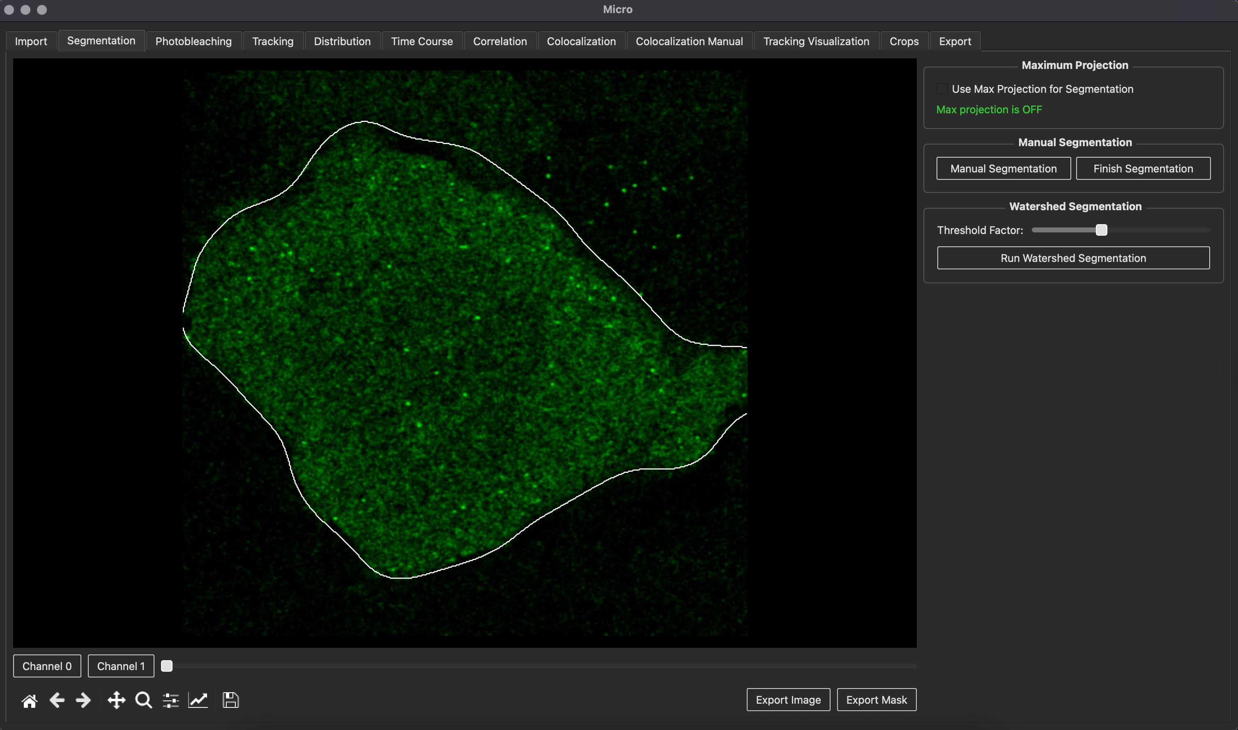
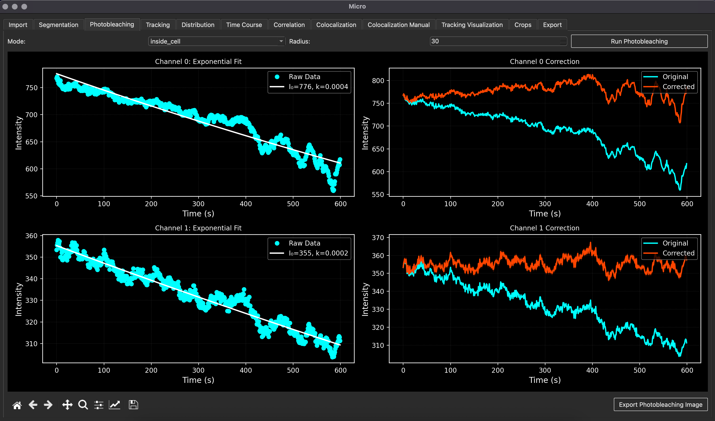
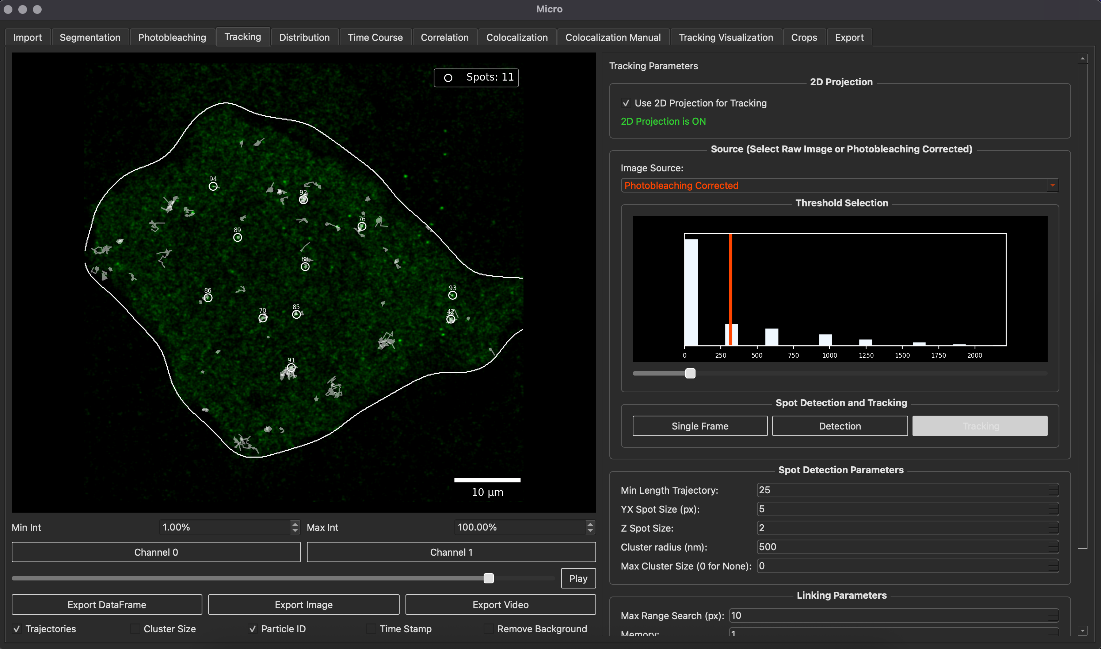
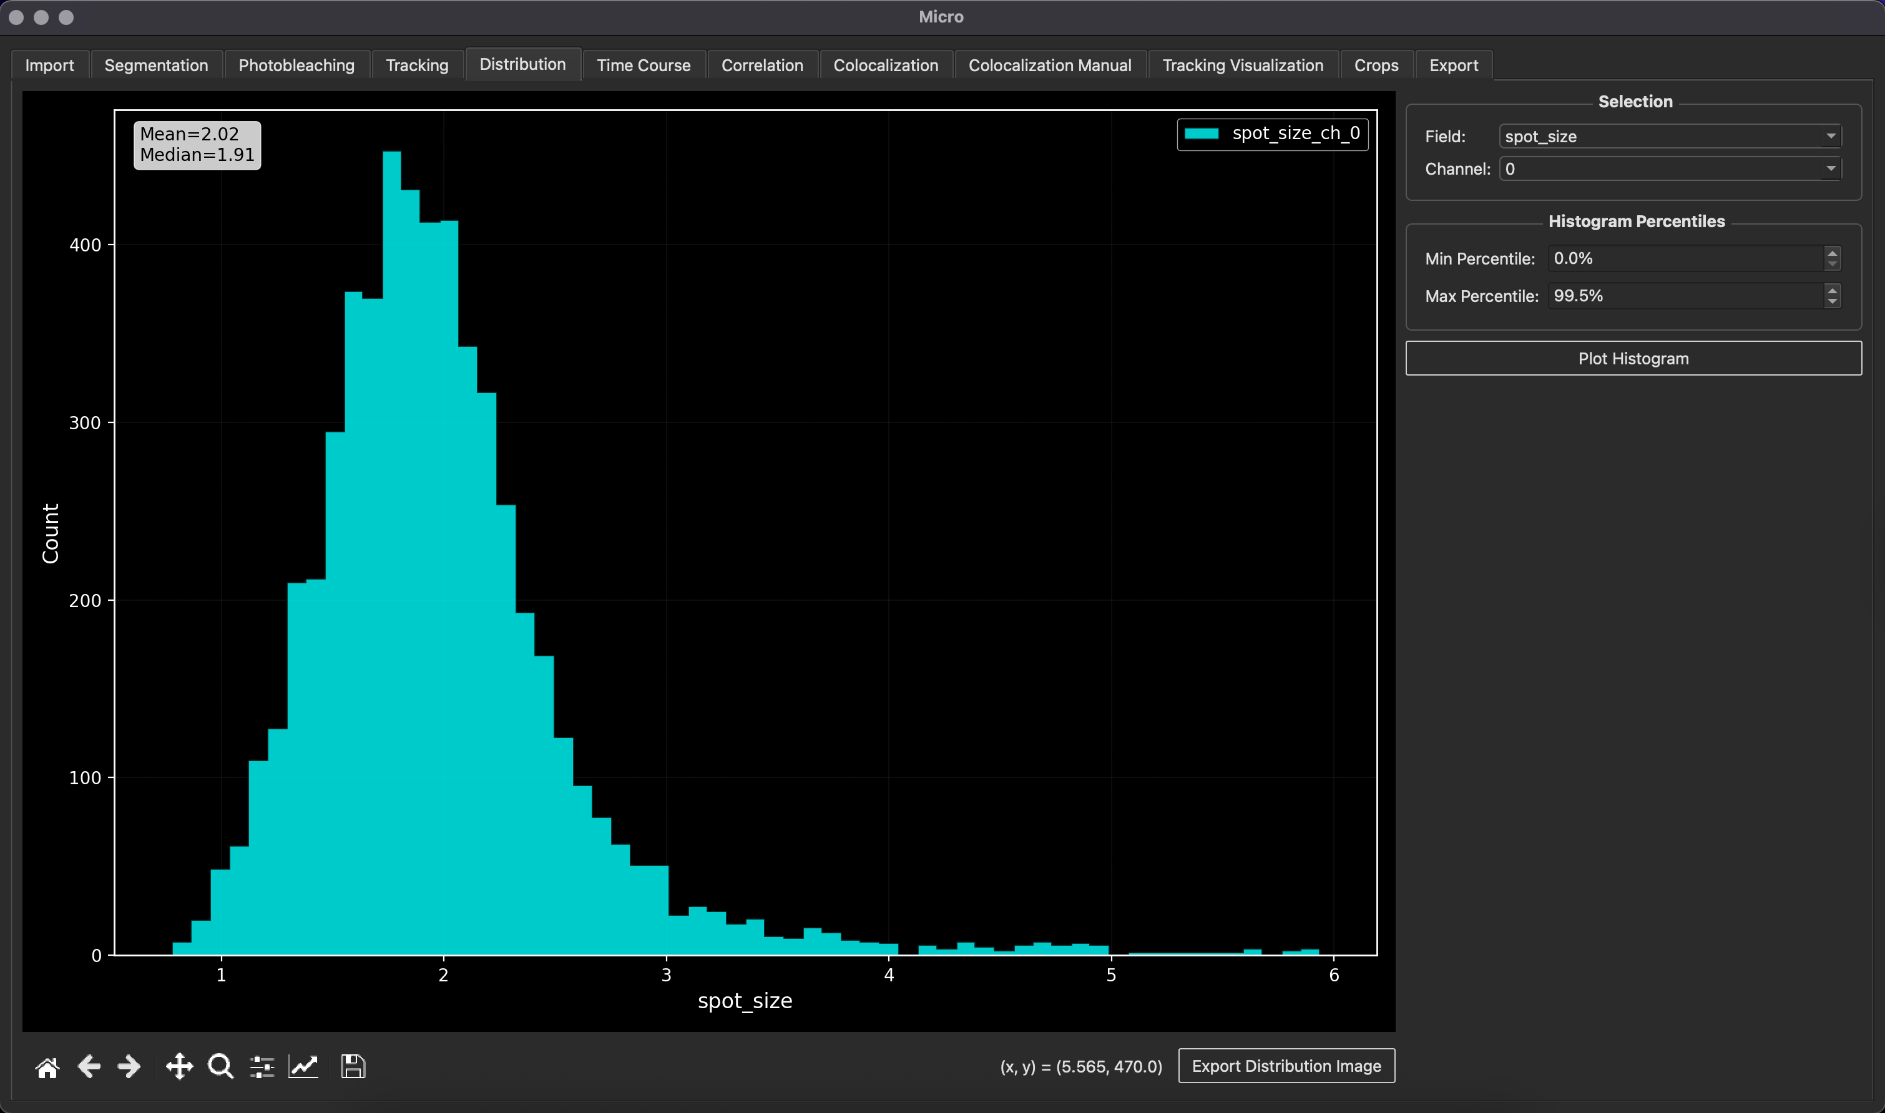
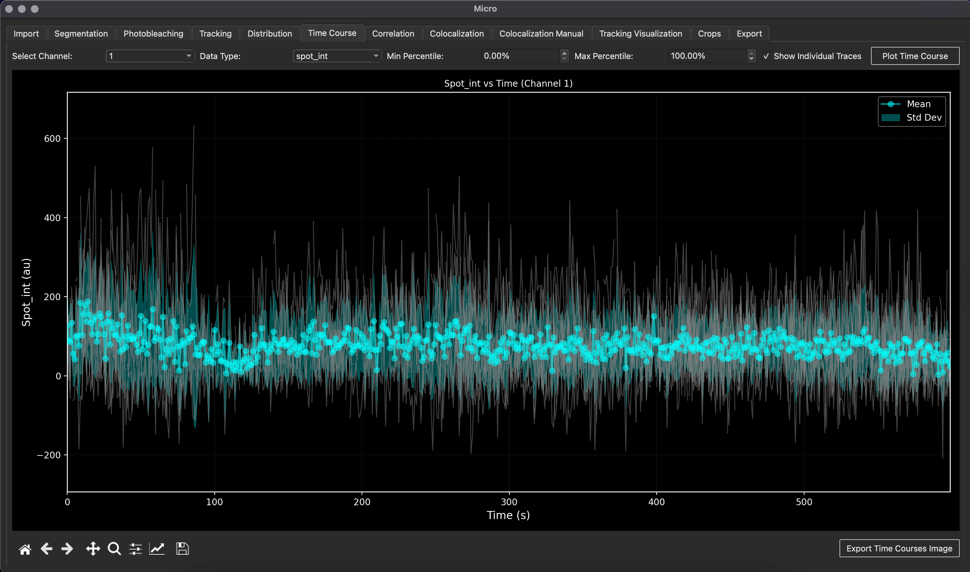
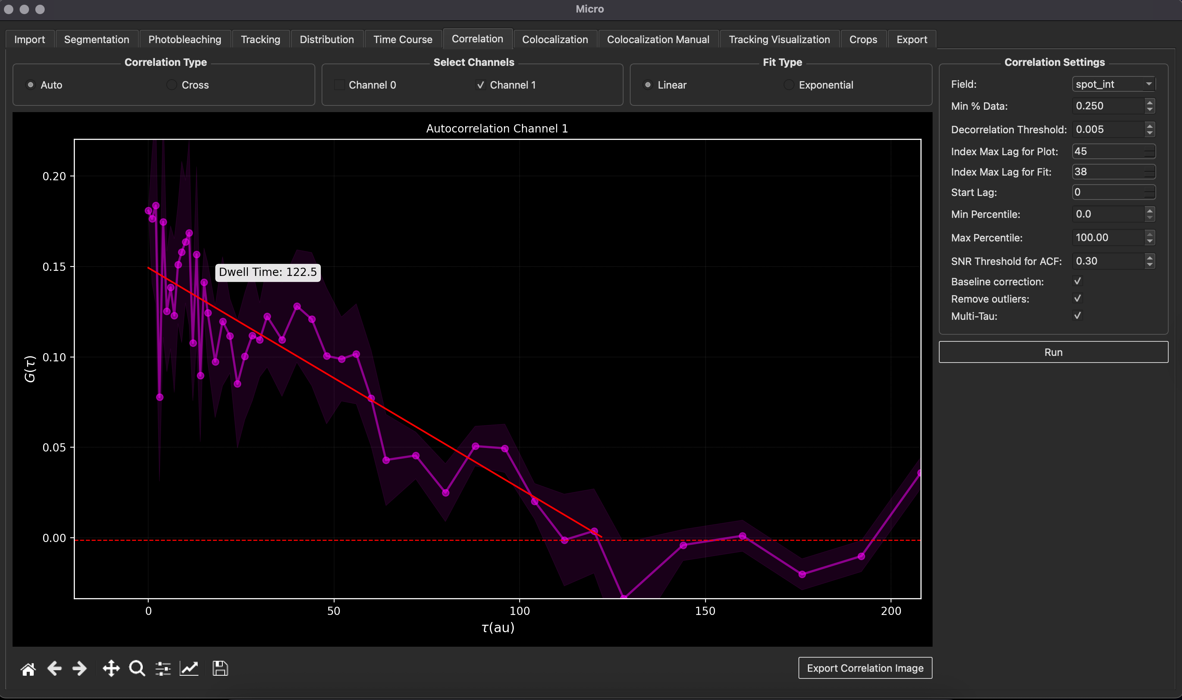
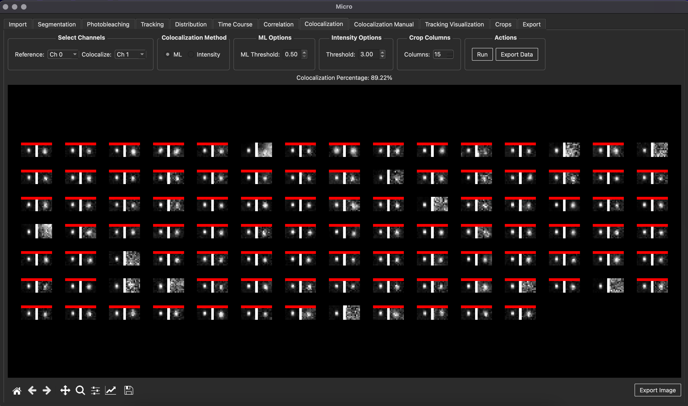
A) Import tab
B) Segmentation tab
C) Photobleaching tab
D) Tracking tab
E) Distribution tab
F) Time Course tab
G) Correlation tab
H) Colocalization tab

Slide 2
MicroLive
Utilities
Preprocessing
Detection
Statistical
Visualization
Import
Segmentation
Tracking
Correlation
Crops
Export
Photobleaching
Time Course
Distribution
Tracking Visualization
Colocalization
Colocalization
Manual

